Slide 1

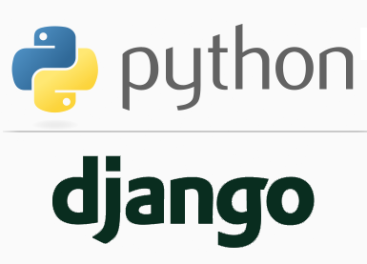
FULL STACK WEB DEVELOPMENT WITH DJANGO
Lecture 13

Slide 2

Today’s Agenda
Developing Our Django App
The Dot LookUp Mechanism
The for Tag
Variables Of for Tag
Example

Slide 3
The Dot Look Up Strategy
When the Django Template System encounters a dot in a variable name, it uses the dot lookups strategy, and tries to find a specific match for the variable from a list of values shown below(in the following order):
Dictionary lookup
Attribute lookup
Method lookup
List lookup
The first matched lookup type is executed by the Django Template System.

Slide 4
Dictionary Look Up
The dictionary lookup is implemented using the dot operator with variable name in the HTML template file.
For example -
dict1.msg
Where:
dict1 is a dictionary implemented in the view function
msg is a specific key in this dictionary, whose value we are going to access in the HTML template file.

Slide 5
Attribute Look Up
The attribute lookup is implemented using the dot operator with variable name in the HTML template file.
For example -
d.day or d.month or d.year
Where:
d refers to an instance of the date class created in the view function
Using the d instance, we are accessing the value of its attributes day, month and year of the date class defined in the same view function

Slide 6
Method Look Up
The method lookup is implemented using the dot operator with variable name in the HTML template file.
For example -
topic.upper or sub_topic.lower
Where:
topic rand sub_topic refer to an instance of the string class created in the view function
Using these instances, we are accessing the methods of string class like upper() , lower() etc.
A point to remember is that we only can call non-parameterized methods

Slide 7
List Look Up
The list lookup is implemented using the dot operator with index number in the HTML template file.
For example -
mylist.0 or mylist.1
Where:
mylist refesr to an instance of the list class created in the view function
Using this instance, we are accessing the index 0 data

Slide 8
The for Tag
The for tag
A for tag allows us to loop through a sequence.
We can use for tag to iterate over the contents of list, tuples, dictionary etc.

Slide 9
The for Tag
Syntax
{% for i in mylist %}
<p>The value of i is {{ i }}</p>
{% endfor %}
When the loop begins the first value from the mylist is assigned to the variable i.
Then the template engine will render everything which falls between {% for %} and {% endfor %}.
This process keeps repeating until there are no more elements left to iterate in the mylist.

Slide 10
The for Tag
The for tag in reverse
To print a list in reverse order we just have to add reversed keyword after the name of list as follows.
{% for i in mylist reversed %}
<p>The value of i is {{ i }}</p>
{% endfor %}

Slide 11
The for Tag
The for tag on dictionary
Similarly, we can access the elements of a dictionary.
Let’s say our context variable contains a dictionary named dict.
dict = { 'uno': 'one', 'dos': 'two', 'tres': 'three', 'cuatro': 'four' }
To access this dictionary inside the template use the following code:
{% for k, v in dict.items %}
<p>{{ k }} : {{ v }}</p>
{% endfor %}
Output:
uno : one
dos : two
tres : three
cuatro : four

Slide 12
The for empty Tag
The for empty tag
Suppose we have a context variable called post_list which is a list of post objects having a data member called title. Our job is to print a list of titles all blog posts.
Can you write the code ?
{% for post in post_list %}
<h2>{{ post.title }}</h2>
{% endfor %}
Can you figure out the problem with the above code ?

Slide 13
The for empty Tag
The for empty tag
The problem is that we haven’t checked whether any blog posts exists or not.
Can you provide a solution ?
{% if post_list %}
{% for post in post_list %}
<h2>{{ post.title }}</h2>
{% endfor %}
{% else %}
No post published yet.
{% endif %}

Slide 14
The for empty Tag
Alternate Solution :The for empty tag
This kind of pattern is so common that Django provides a nice shortcut to it.
The for tag can take an additional {% empty %} tag. This tag let you define what to output in the case if list is empty.
{% for post in post_list %}
<h2>{{ post.title }}</h2>
{% empty %}
No post published yet.
{% endfor %}

Slide 15
The for Tag Variables
The for tag variable
The for tag provides a special variable called forloop.
The forloop variable has few attributes that we can use to track the progress of the loop..

Slide 16
The for Tag Variables
The forloop.counter:– It returns a number indicating the current iteration of the loop. It starts with 1.
Suppose our context contains a list named list defined as follows:
list = [11,12,13]
{% for i in list %}
<p>{{ forloop.counter }} Iteration - {{ i }}</p>
{% endfor %}
Output:
1 Iteration - 11
2 Iteration - 12
3 Iteration - 13

Slide 17
The for Tag Variables
The forloop.counter0 – Works same as forloop.counter but begins with 0 instead of 1.
{% for i in list %}
<p>{{ forloop.counter0 }} Iteration - {{ i }}</p>
{% endfor %}
Output:
0 Iteration - 11
1 Iteration - 12
2 Iteration - 13

Slide 18
The for Tag Variables
The forloop.revcounter – It returns the number of iteration from the end of the loop.
{% for i in list %}
<p>{{ forloop.revcounter }} Iteration - {{ i }}</p>
{% endfor %}
Output:
3 Iteration - 11
2 Iteration - 12
1 Iteration - 13

Slide 19
The for Tag Variables
The forloop.revcounter0 – Same as forloop.revcounter but it is 0 indexed.
{% for i in list %}
<p>{{ forloop.revcounter0 }} Iteration - {{ i }}</p>
{% endfor %}
Output:
2 Iteration - 11
1 Iteration - 12
0 Iteration - 13

Slide 20
The for Tag Variables
The forloop.first – It returns a Boolean True if the current iteration is the first iteration. Otherwise False.
{% for i in list %}
<p>{{ forloop.first }} Iteration - {{ i }}</p>
{% endfor %}
Output:
True Iteration - 11
False Iteration - 12
False Iteration - 13

Slide 21
The for Tag Variables
The forloop.last – It returns a Boolean True if the current iteration is the last iteration. Otherwise False.
{% for i in list %}
<p>{{ forloop.last }} Iteration - {{ i }}</p>
{% endfor %}
Output:
False Iteration - 11
False Iteration - 12
True Iteration - 13

Slide 22

Exercise
Suppose you have following data extracted from Emp table:
Write a Django App using templates which displays this complete data as shown on the next slide
EmpNo | Ename | Salary | Hiredate
101 | Amit | 50000.0 | August 27,2018
102 | Deepak | 45000.0 | November 29,2018

Slide 23
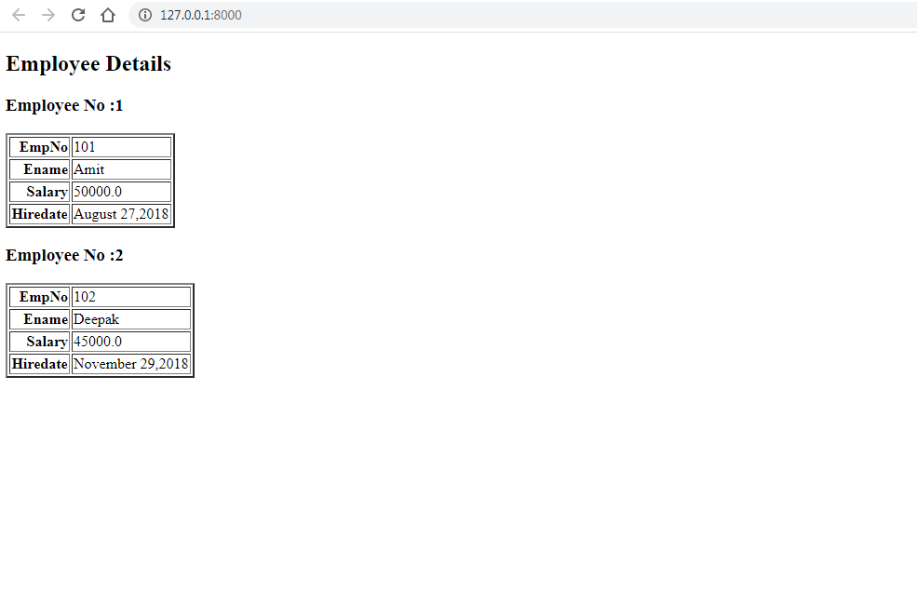
Exercise

